Slide 1
Splay Trees
A splay tree is a self-adjusting binary search tree with the additional property that recently accessed elements are quick to access again.
It performs basic operations such as insertion, look-up(search) and removal in O(log n) amortized time.
For many sequences of non-random operations, splay trees perform better than other search trees, even when the specific pattern of the sequence is unknown.
The splay tree was invented by Daniel Sleator and Robert Tarjan in 1985.

Slide 2
All normal operations on a binary search tree are combined with one basic operation, called splaying.
Splaying the tree for a certain element rearranges the tree so that the element is placed at the root of the tree.
One way to do this with the basic search operation is to first perform a standard binary tree search for the element in question, and then use tree rotations in a specific fashion to bring the element to the top.

Slide 3
Advantages
Good performance for a splay tree depends on the fact that it is self-optimizing, in that frequently accessed nodes will move nearer to the root where they can be accessed more quickly.
The worst-case height—though unlikely—is O(n), with the average being O(log n).
Having frequently used nodes near the root is an advantage for many practical applications, and is particularly useful for implementing caches and garbage collection algorithms.
Advantages :
Comparable performance: Average-case performance is as efficient as other trees.
Small memory footprint: Splay trees do not need to store any bookkeeping data.

Slide 4
Disadvantages
The most significant disadvantage of splay trees is that the height of a splay tree can be linear.
For example, this will be the case after accessing all n elements in non-decreasing order.
Since the height of a tree corresponds to the worst-case access time, this means that the actual cost of an operation can be high. However the amortized access cost of this worst case is logarithmic, O(log n).
Also, the expected access cost can be reduced to O(log n) by using a randomized variant.

Slide 5
The representation of splay trees can change even when they are accessed in a 'read-only' manner (i.e. by find operations).
This complicates the use of such splay trees in a multi-threaded environment.
Specifically, extra management is needed if multiple threads are allowed to perform find operations concurrently.
This also makes them unsuitable for general use in purely functional programming, although even there they can be used in limited ways to implement priority queues.

Slide 6
Operations
Splaying
When a node x is accessed, a splay operation is performed on x to move it to the root.
To perform a splay operation we carry out a sequence of splay steps, each of which moves x closer to the root.
By performing a splay operation on the node of interest after every access, the recently accessed nodes are kept near the root and the tree remains roughly balanced, so that we achieve the desired amortized time bounds.

Slide 7
Each particular step depends on three factors:
Whether x is the left or right child of its parent node, p,
whether p is the root or not, and if not
whether p is the left or right child of its parent, g (the grandparent of x).
It is important to remember to set gg (the great-grandparent of x) to now point to x after any splay operation.
If gg is null, then x obviously is now the root and must be updated as such.

Slide 8
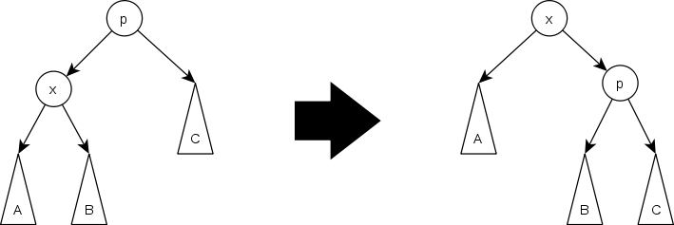
There are three types of splay steps, each of which has a left- and right-handed case. For the sake of brevity, only one of these two is shown for each type.
These three types are:
Zig step: This step is done when p is the root.
The tree is rotated on the edge between x and p.
Zig steps exist to deal with the parity issue and will be done only as the last step in a splay operation and only when x has odd depth at the beginning of the operation.

Slide 9
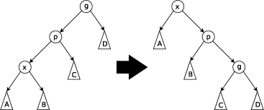
Zig-zig step: This step is done when p is not the root and x and p are either both right children or are both left children.
The picture below shows the case where x and p are both left children. The tree is rotated on the edge joining p with its parent g, then rotated on the edge joining x with p.
Note that zig-zig steps are the only thing that differentiate splay trees from the rotate to root method introduced by Allen and Munro prior to the introduction of splay trees.

Slide 10
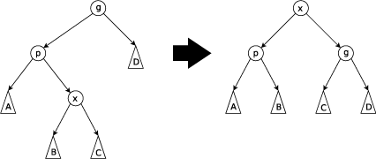
Zig-zag step: this step is done when p is not the root and x is a right child and p is a left child or vice versa.
The tree is rotated on the edge between p and x, and then rotated on the resulting edge between x and g.

Slide 11
Join
Given two trees S and T such that all elements of S are smaller than the elements of T, the following steps can be used to join them to a single tree:
Splay the largest item in S. Now this item is in the root of S and has a null right child.
Set the right child of the new root to T.
Split
Given a tree and an element x, return two new trees: one containing all elements less than or equal to x and the other containing all elements greater than x. This can be done in the following way:
Splay x. Now it is in the root so the tree to its left contains all elements smaller than x and the tree to its right contains all element larger than x.
Split the right subtree from the rest of the tree.

Slide 12
Insertion
To insert a value x into a splay tree:
Insert x as with a normal binary search tree.
when an item is inserted, a splay is performed.
As a result, the newly inserted node x becomes the root of the tree.
ALTERNATIVE:
Use the split operation to split the tree at the value of x to two sub-trees: S and T.
Create a new tree in which x is the root, S is its left sub-tree and T its right sub-tree.

Slide 13
Deletion
To delete a node x, use the same method as with a binary search tree:
If x has two children, swap its value with that of either the rightmost node of its left sub tree (its in-order predecessor) or the leftmost node of its right subtree (its in-order successor). Then remove that node instead. In this way, deletion is reduced to the problem of removing a node with 0 or 1 children.
Unlike a binary search tree, in a splay tree after deletion, we splay the parent of the removed node to the top of the tree.
ALTERNATIVE:
The node to be deleted is first splayed, i.e. brought to the root of the tree and then deleted. leaves the tree with two sub trees.
The two sub-trees are then joined using a "join" operation.

